Slide 1



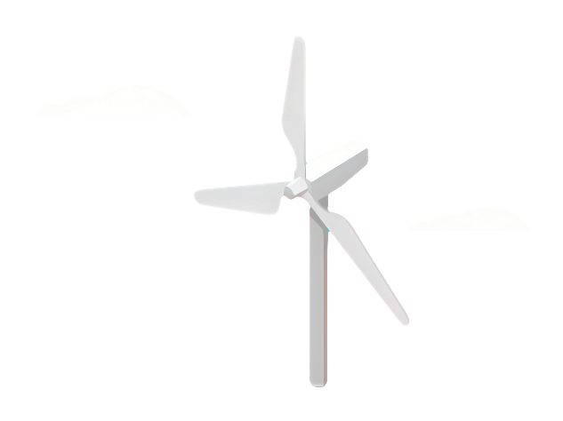
Weekly Report: Rotor Blade Design
Week number: 01
Date: 23.09.2025
Supervisor: Prof. Dr. rer. nat. Alois Schaffarczyk
Group Members: Jay Pandya, Kandarp Pathak, Harsh Panchal, Daniyal Sikandar

Slide 2
Why Rotor Blade Design?
Rotor blades are heart of a wind turbine.
Shape, Material, and aerodynamics determine energy capture efficiency.
Global shift toward renewable energy, especially wind power, increases the importance of blade innvoation.
Rotor blade design improves turbine efficiency, durability, and cost-effectiveness.
This project applies engineering principles like aerodynamics, materials science, and structural analysis to support cleaner and more reliable wind energy systems.

Slide 3
Software Tools for Rotor Blade Design
FORTRAN
Used for computational analysis and custom coding.
Helps in implementing Blade Element Momentum (BEM) theory and aerodynamic equations.
Provides flexibility to test mathematical models for rotor blade performance.
QBlade
Open-source software specialized in wind turbine blade design and simulation.
Allows airfoil analysis, rotor design, and performance prediction.
Integrated with XFOIL for aerodynamic calculations.
Useful for validating our theoretical results and optimizing the blade geometry.

Slide 4
Workflow Chart
1. Project Initiation
2. Conceptual Design
3. Theoretical Analysis
4. Simulation & Modelling
5. Structural & Material Considerations
6. Optimization
7. Final Design & Documentation

Slide 5
Week 1 – Work Done
Tasks Completed:
Identified the software tools for the project: FORTRAN and QBlade.
Explored and tried basic functions of the software.
Studied last year’s project report to understand past approaches.
Reviewed research papers related to rotor blade design.
Attempted the activity assigned by the professor.
Challenges:
Could not complete the professor’s activity due to uncertainty about the next steps.
Need further guidance to proceed effectively.
Next Steps:
Clarify the activity requirements with the professor.
Start a structured plan for applying the software to rotor blade design.
Continue literature review and finalize the tools for simulation and analysis.

Slide 6
Bibliography
McGugan, M. (2016). Design of Wind Turbine Blades. In W. Ostachowicz et al. (Eds.), MARE-WINT (pp. 13–32). Springer.
Firoozi, A. A., Hejazi, F., & Firoozi, A. A. (2024). Advancing Wind Energy Efficiency: A Systematic Review of Aerodynamic Optimization in Wind Turbine Blade Design. Energies, 17(2919).
Matsson, J. E., Voth, J., McCain, C. A., & McGraw, C. (2016, June). Aerodynamic Performance of the NACA 2412 Airfoil at Low Reynolds Number. American Society for Engineering Education (ASEE) Conference Paper.
Schubel, P. J., & Crossley, R. J. (2012). Wind Turbine Blade Design. Energies, 5(9), 3425–3449.

